Slide 1
5.1 Standard Form, Mood, and Figure
An Example of a Categorical Syllogism
All soldiers are patriots.
No traitors are patriots.
Therefore no traitors are soldiers.
The Four Conditions of Standard Form
All three statements are standard-form categorical propositions.
The two occurrences of each term are identical.

Slide 2
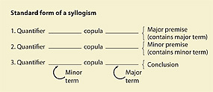
5.1 Continued (Part 1)
Each term is used in the same sense throughout the argument.
The major premise is listed first, the minor premise second, and the conclusion last.

Slide 3
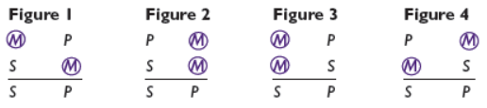
5.1 Continued (Part 2)
The Mood of a Categorical Syllogism consists of the letter names that make it up.
S = subject of the conclusion (minor term)
P = predicate of the conclusion (minor term)
M = middle term

Slide 4
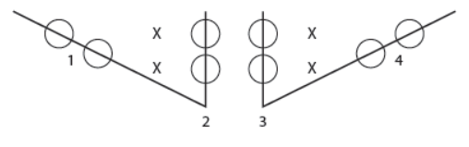
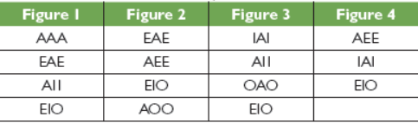
5.1 Continued (Part 3)
The Figure of a Categorical Syllogism
Unconditional Validity

Slide 5
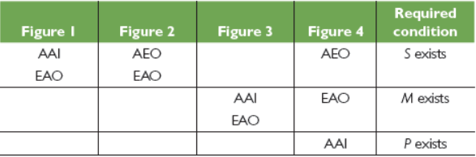
5.1 Continued (Part 4)
Conditional Validity

Slide 6
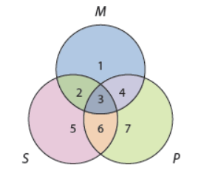
5.2 Venn Diagrams
Constructing Venn Diagrams for Categorical Syllogisms: Seven “Pointers”
Most intuitive and easiest-to-remember technique for testing the validity of categorical syllogisms.

Slide 7
5.2 Continued (Part 1)
Testing for Validity from the Boolean Standpoint
Do shading first.
Never enter the conclusion.
If the conclusion is already represented on the diagram the syllogism is valid.

Slide 8
5.2 Continued (Part 2)
Testing for Validity from the Aristotelian Standpoint:
Reduce the syllogism to its form and test from the Boolean standpoint.
If invalid from the Boolean standpoint, and there is a circle completely shaded except for one region, enter a circled “X” in that region and retest the form.
If the form is syllogistically valid and the circled “X” represents something that exists, the syllogism is valid from the Aristotelian standpoint.

Slide 9
5.3 Rules and Fallacies
The Boolean Standpoint
Rule 1: The middle term must be distributed at least once.
All sharks are fish.
All salmon are fish.
All salmon are sharks.

Slide 10
5.3 Continued (Part 1)
Rule 2: If a term is distributed in the conclusion, then it must be distributed in a premise.
All horses are animals.
Some dogs are not horses.
Some dogs are not animals.
All tigers are mammals. All mammals are animals. All animals are tigers.

Slide 11
5.3 Continued (Part 2)
Rule 3. Two negative premises are not allowed.
No fish are mammals.
Some dogs are not fish.
Some dogs are not mammals.

Slide 12
5.3 Continued (Part 3)
Rule 4. A negative premise requires a negative conclusion, and a negative conclusion requires a negative premise.
All crows are birds.
Some wolves are not crows.
Some wolves are birds.

Slide 13
5.3 Continued (Part 4)
Rule 5. If both premises are universal, the conclusion cannot be particular.
All mammals are animals.
All tigers are mammals.
Some tigers are animals.

Slide 14
5.3 Continued (Part 5)
The Aristotelian Standpoint
Any Categorical Syllogism that breaks any of the first 4 rules is invalid. However, if a syllogism breaks rule number 5, but at least one of its terms refers to something existing, it is valid from the Aristotelian standpoint on condition.
Proving the Rules
If a syllogism breaks none of these rules, it is valid, but there is no quick way to prove it.

Slide 15
5.4 Reducing the Number of Terms
Testing Categorical Syllogisms in ordinary language requires that the number of terms be “reduced” through the use of conversion, obversion, and contraposition.
Example:
Ordinary Language | Symbolized Argument | Reduced Argument
All photographers are non-writers. | All P are non-W | No P are W
Some editors are writers. | Some E are W | Some E are W
Therefore, some non-photographers are not non-editors. | Some non-P are not non-E | Some E are not P

Slide 16
5.5 Ordinary Language Arguments
Translating ordinary language arguments into standard form.
All times people delay marriage, the divorce rate decreases.
All present times are times people delay marriage.
Therefore all present times are times the divorce rate decreases.

Slide 17
5.5 Continued
Symbolizing After Translating
M = times people delay marriage
D = times the divorce rate decreases
P = present times
All M are D
All P are M
All P are D

Slide 18
5.6 Enthymemes
Enthymeme: an argument expressed as a categorical syllogism that is missing a premise or conclusion.
The corporate income tax should be abolished; it encourages waste and high prices.
The missing premise is below; translate into standard form:
Whatever encourages waste and high prices should be abolished.

Slide 19
5.7 Sorites
Sorites: A chain of Categorical Syllogism in which the intermediate conclusions have been left out
All bloodhounds are dogs.
All dogs are mammals.
No fish are mammals.
Therefore no fish are bloodhounds.

Slide 20
5.7 Continued
Testing Sorites for Validity
Put the sorites into standard form.
Introduce the intermediate conclusions.
Test each component for validity.

